Slide 1
Country Education and Quality of Life
DATASCI 112 Final Project

Slide 2
A Backstory
Notes:
-came in wanting to do something unique and interesting to me
-was gonna do the NBA/basketball
-march madness was coming up
-complications pulling data
-decided to do the next closest thing

Slide 3
Best Factors For Determining Winning in the NBA
DATASCI 112 Final Project

Slide 4
Country Education and Quality of Life
DATASCI 112 Final Project

Slide 5
Economic Development & GDP
DATASCI 112 Final Project

Slide 6
Data Collection

Slide 7
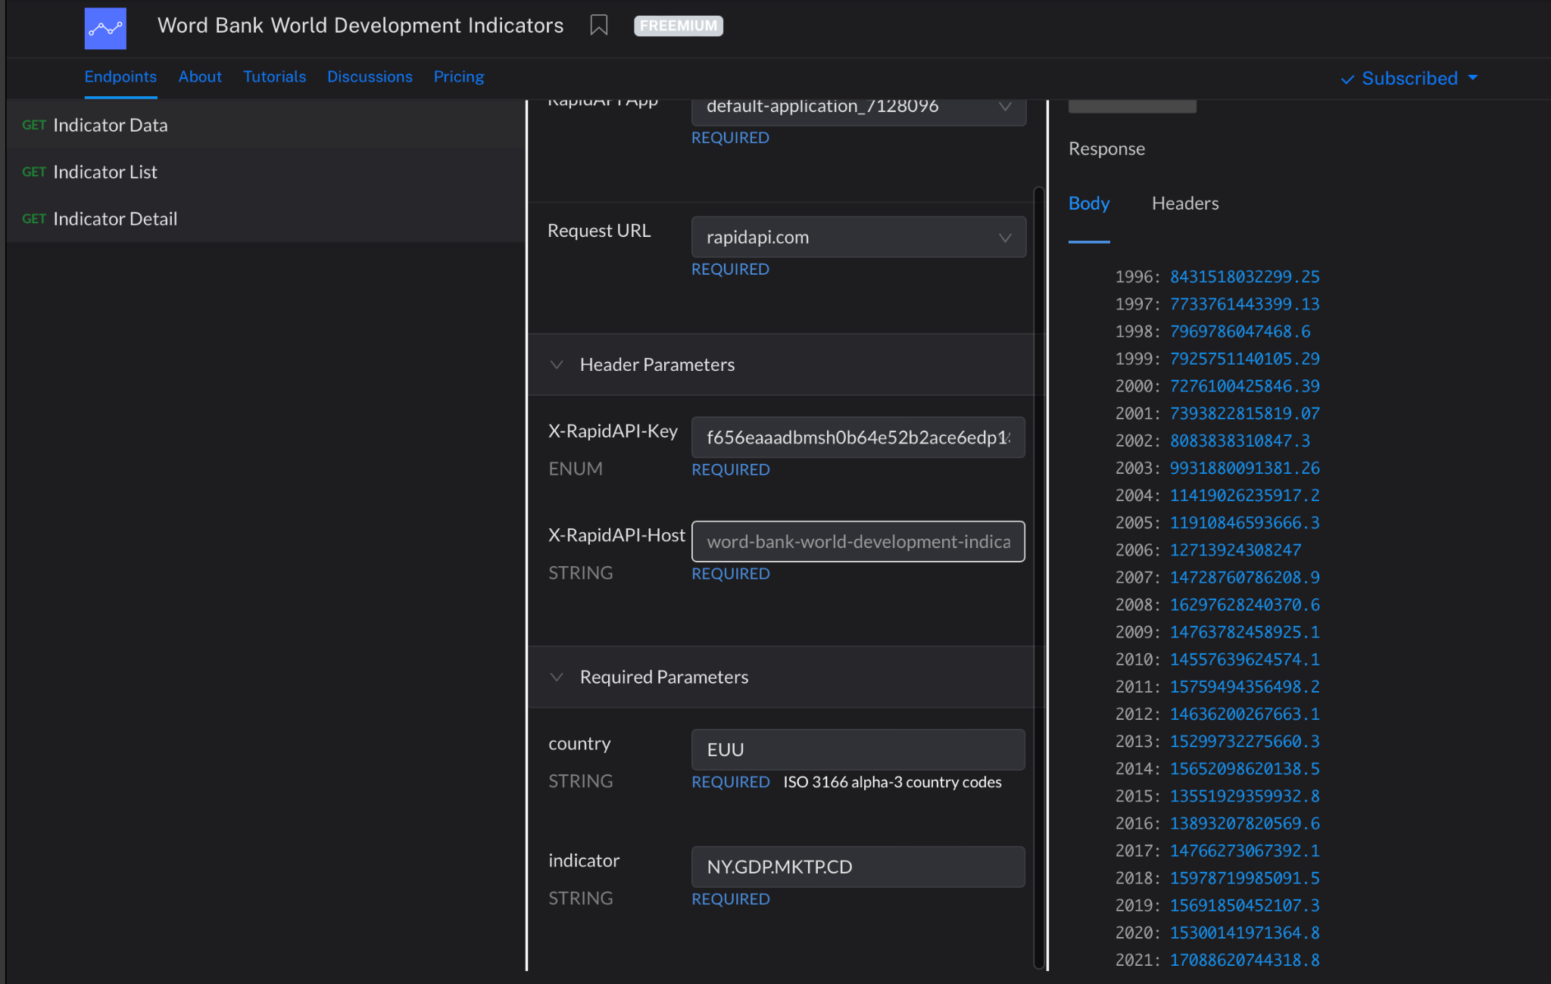
How I Collected My Data
Found the Rest API

Slide 8
How I Collected My Data
2. Got a list of Indicator Codes

Slide 9
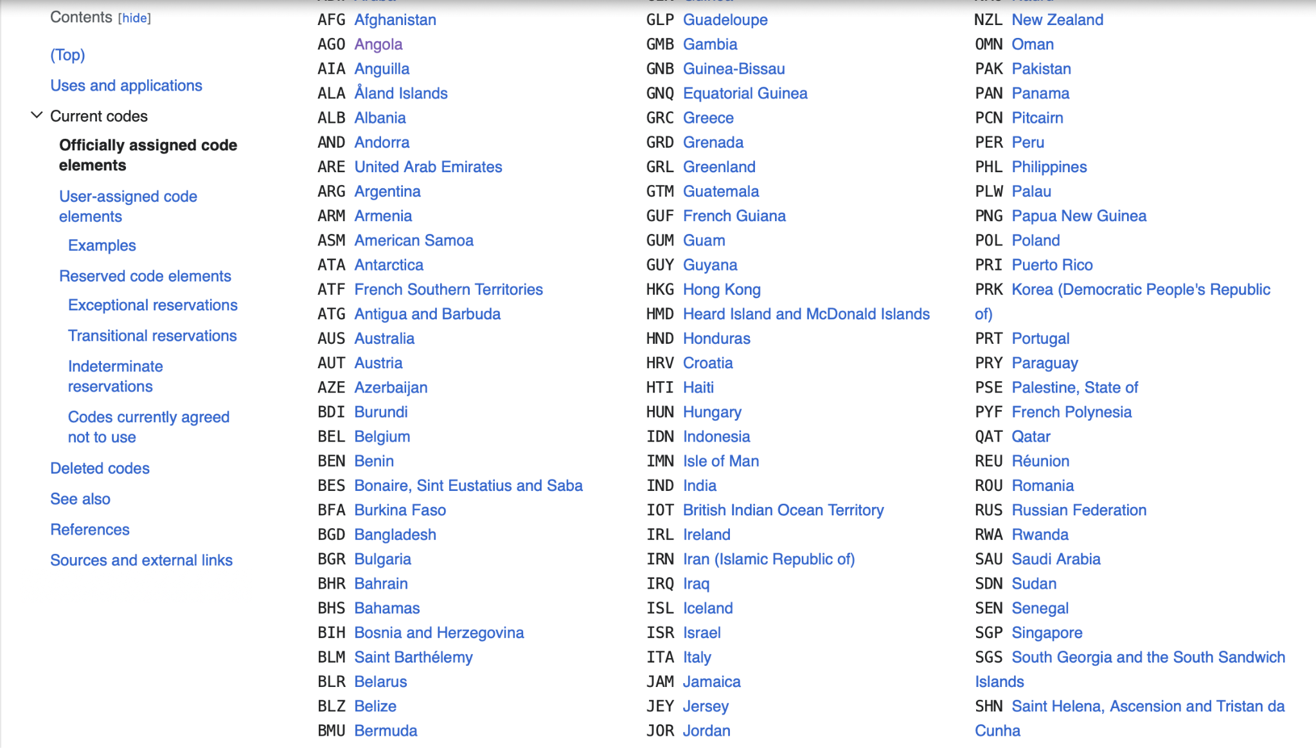
How I Collected My Data
3. Scraped a list of Country Codes from Wikipedia

Slide 10
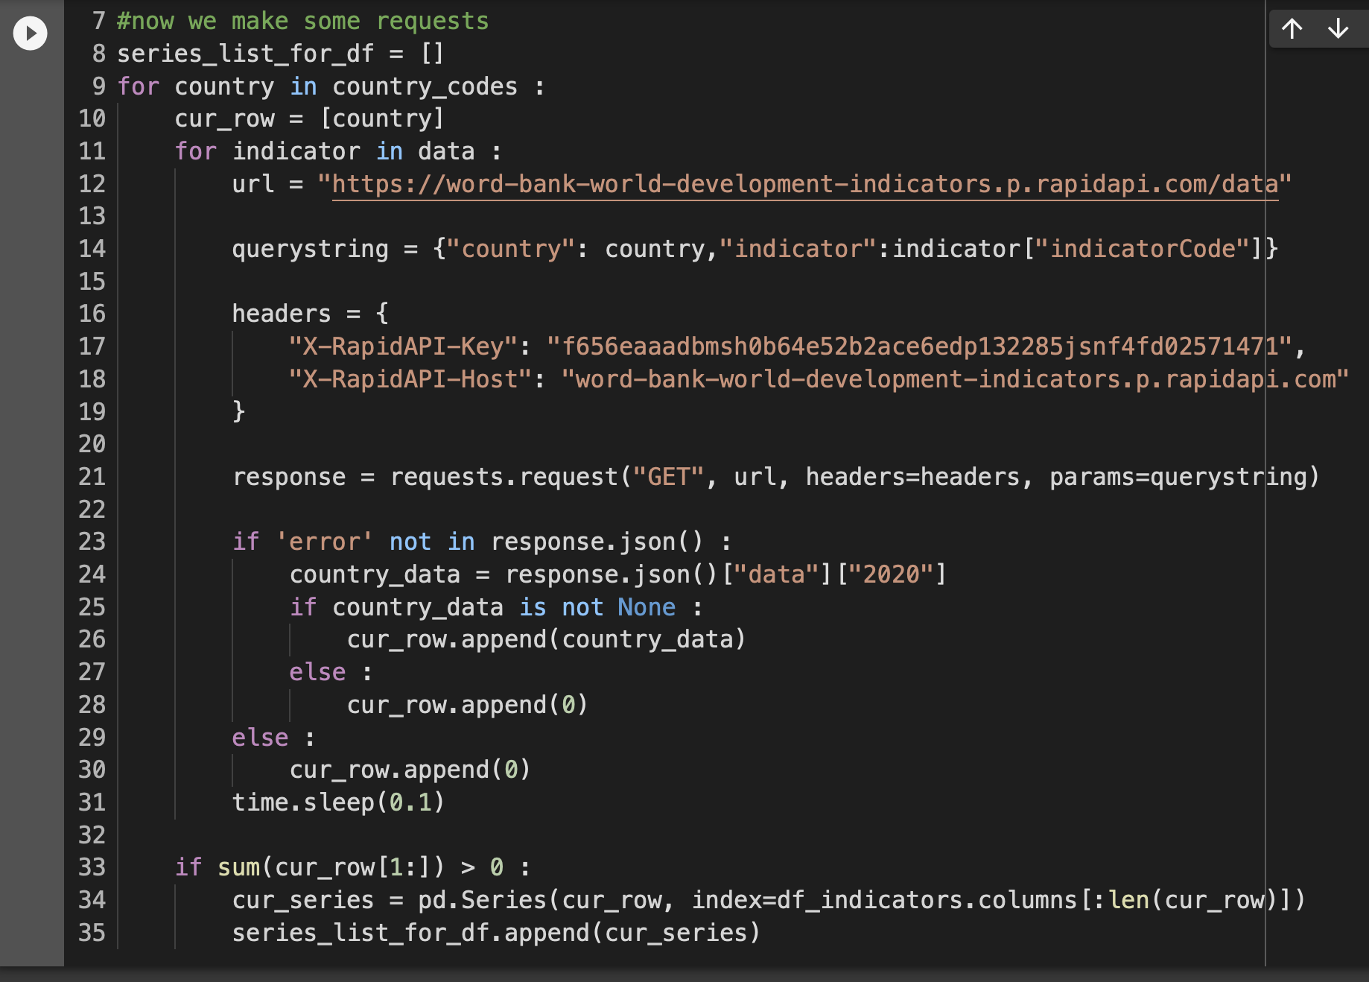
How I Collected My Data
4. Pulled the data for all countries and indicators for 2020 and put them into a dataframe

Slide 11
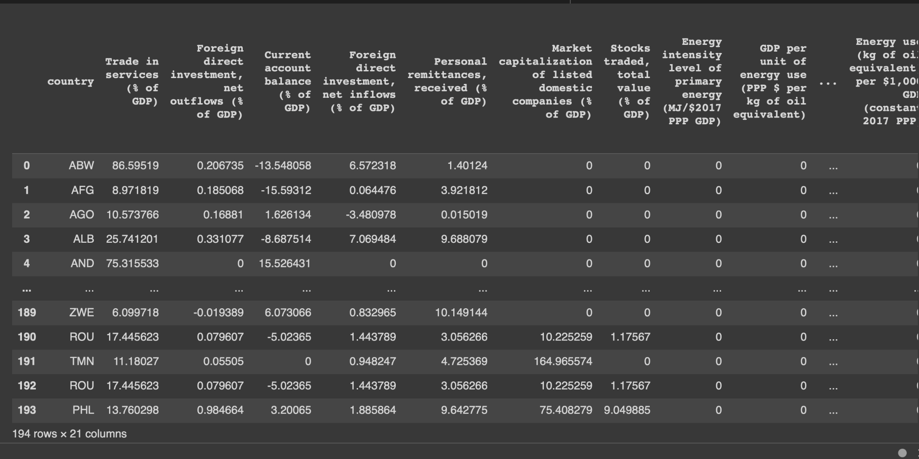
The (Tentative Result)

Slide 12
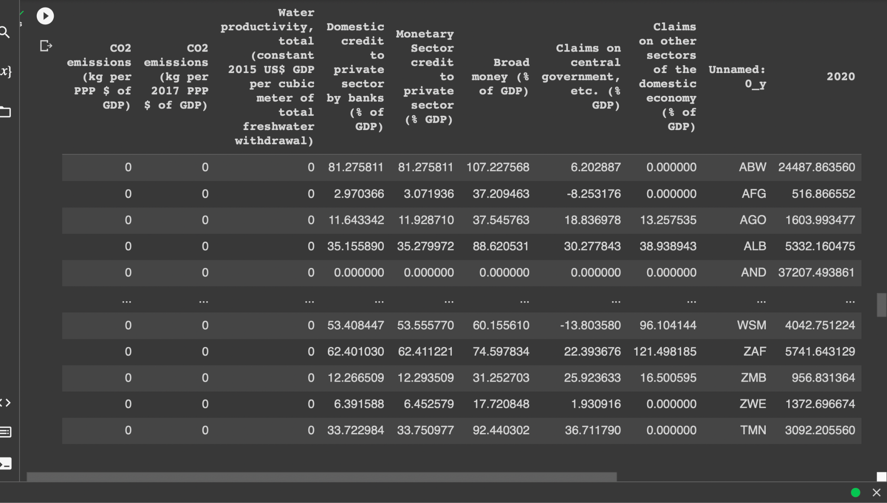
How I Collected My Data
5. Found a CSV file of every country’s 2020 gdp per capita & joined the two datasets

Slide 13
Exploration & Analysis

Slide 14
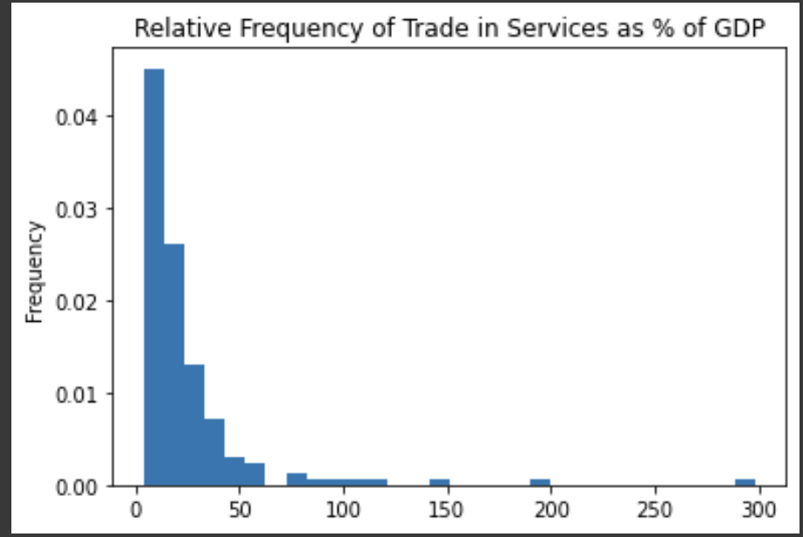
Exploration #1: Trade in Services
“Records the value of services exchanged between residents and non-residents of an economy”
-Why is there such a large data point around 300%?

Slide 15
Exploration #1: Trade in Services
What’s the deal with Luxembourg?
-Luxembourg had a relatively low GDP of ~$75 billion in 2020
-Economy is heavily dependent on financial services
-Total nearly tripled their GDP in total trade

Slide 16
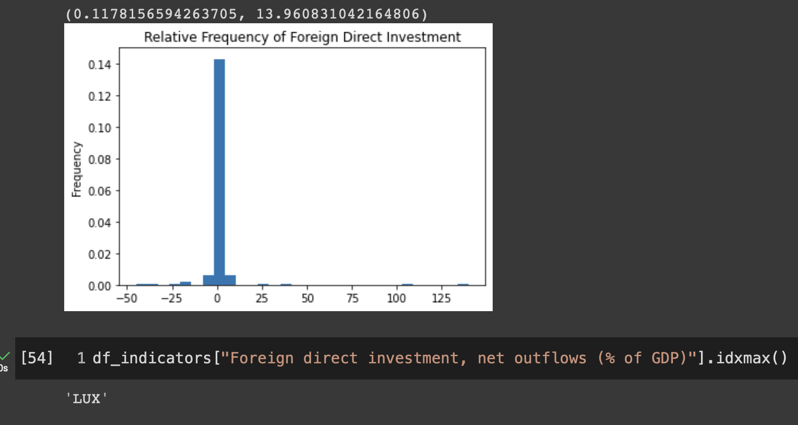
Luxembourg Shenanigans
Luxembourg also appeared as an outlier in foreign direct investment:
“the value of inward direct investment made by non-resident investors in the reporting economy”

Slide 17
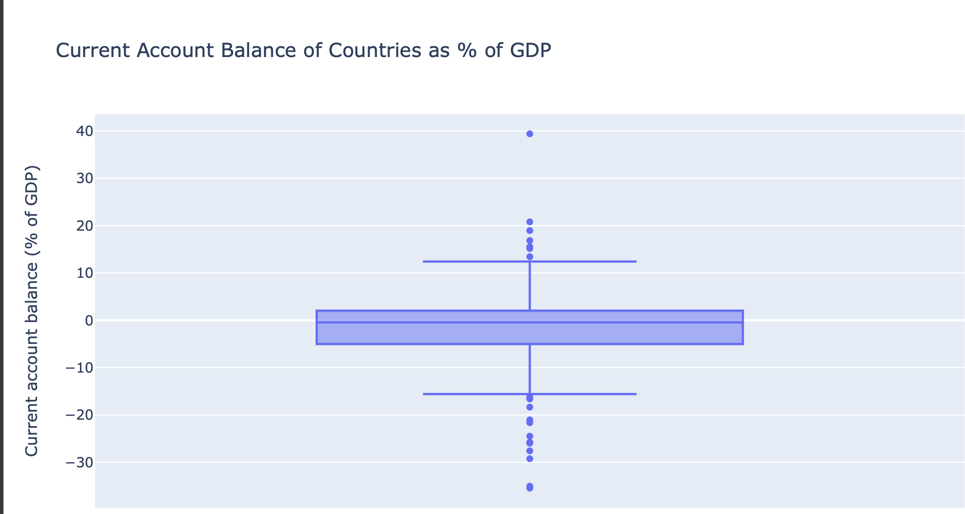
Exploration #2: Current Account Balance
“a record of a country's international transactions with the rest of the world”
Mmm … more outliers, let’s explore

Slide 18
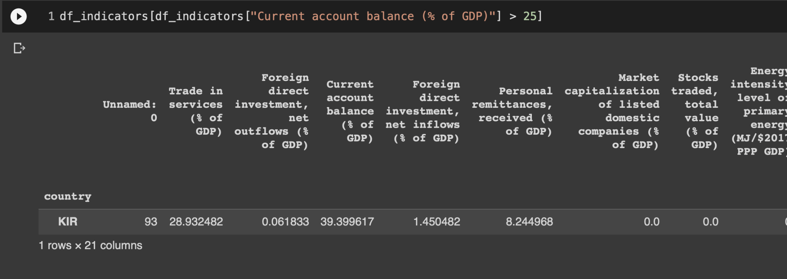
Exploration #2: Current Account Balance
Upper Outlier: Kiribati:
-small country w/ low GDP
-primarily subsistence economy → not many foreign interactions → skewed data point

Slide 19
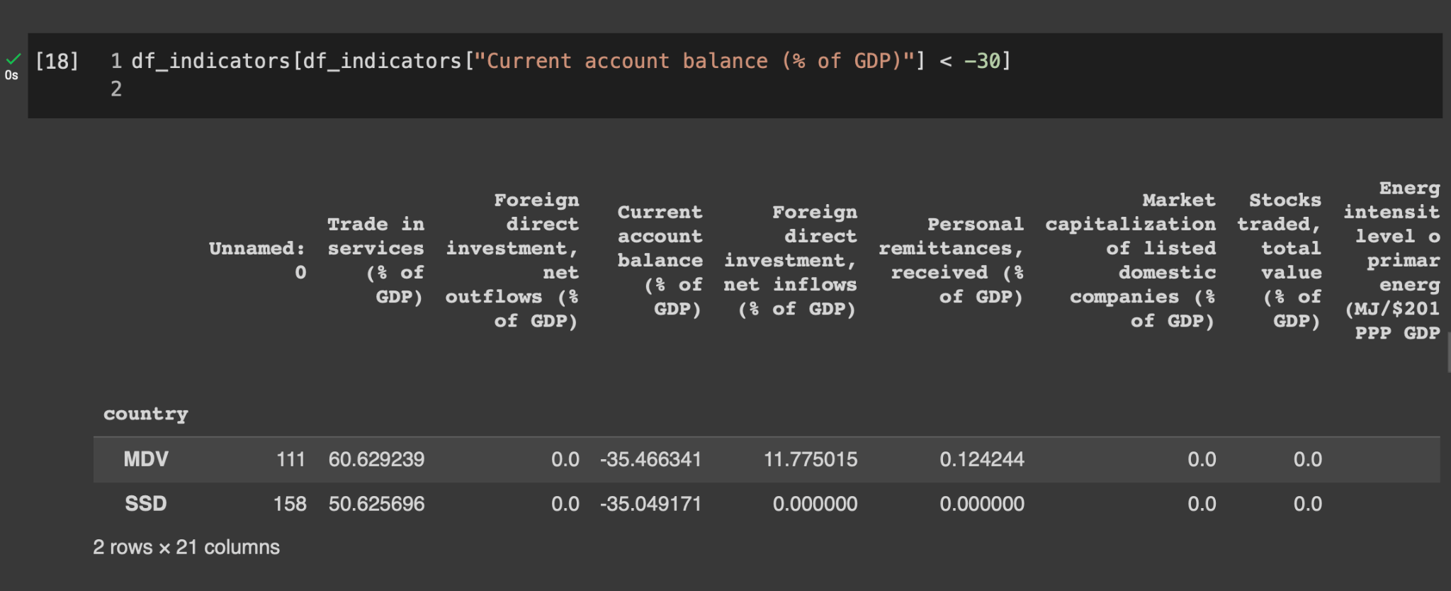
Exploration #2: Current Account Balance
Lower Outliers: the Maldives and South Sudan
Maldives: heavily relies on tourism, which was impacted by COVID
South Sudan: in economic turmoil following 2011 separation from Sudan and recovering from 2013-2018 Civil War

Slide 20
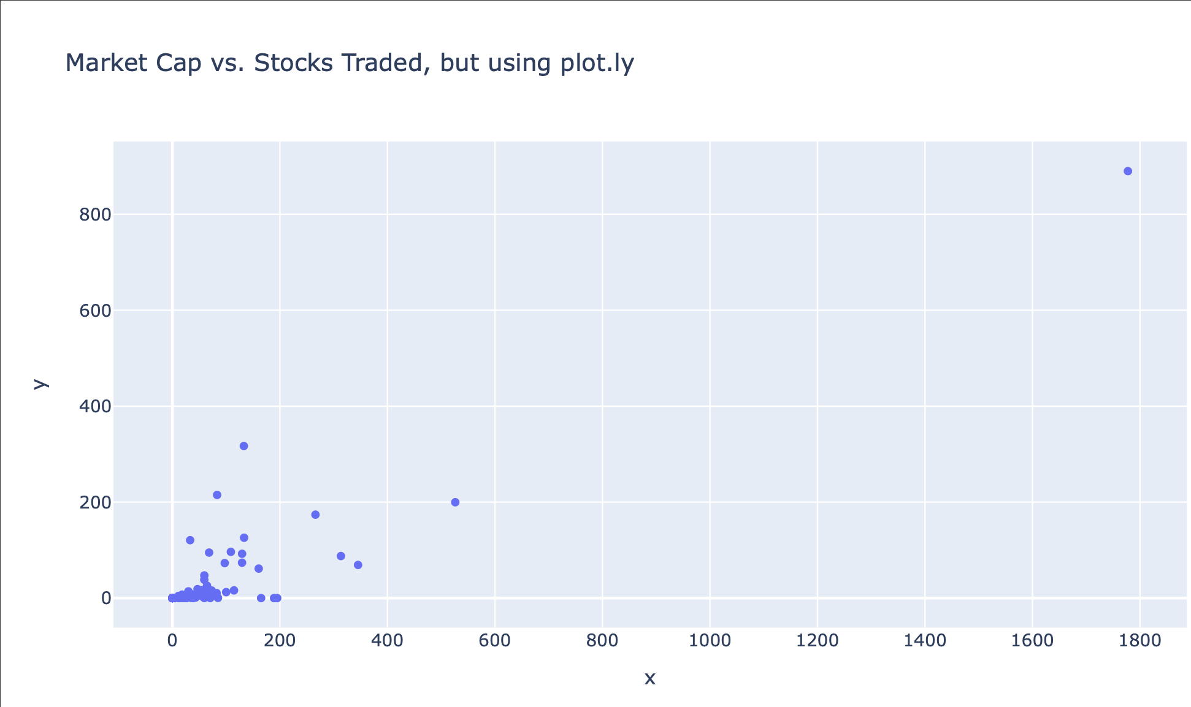
Exploration #3: Market Capitalization and Stocks Traded
Hmmm … another outlier
Let’s check it out

Slide 21
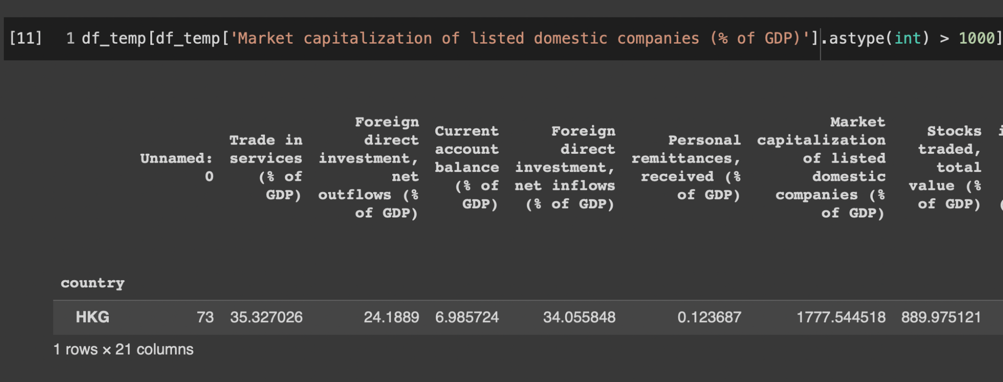
Exploration #3: Market Capitalization and Stocks Traded
What country is HKG??

Slide 22
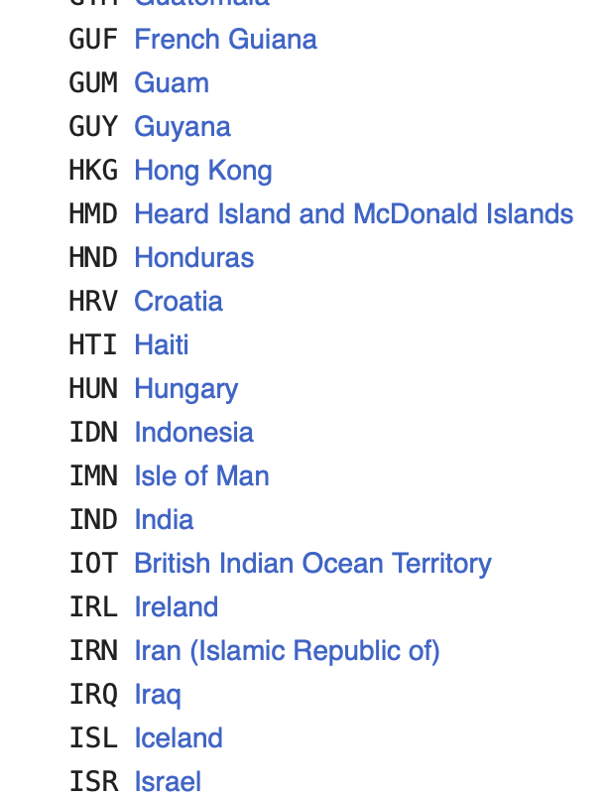
Exploration #3: Market Capitalization and Stocks Traded
Hong Kong is an “administrative region”
Possible Explanations:
Data Entry Error (always a possibility)
Technicality (more likely)
Stocks traded and stock market cap → China
GDP → Hong Kong production
As a result: China Investments / Hong Kong GDP = outliers

Slide 23
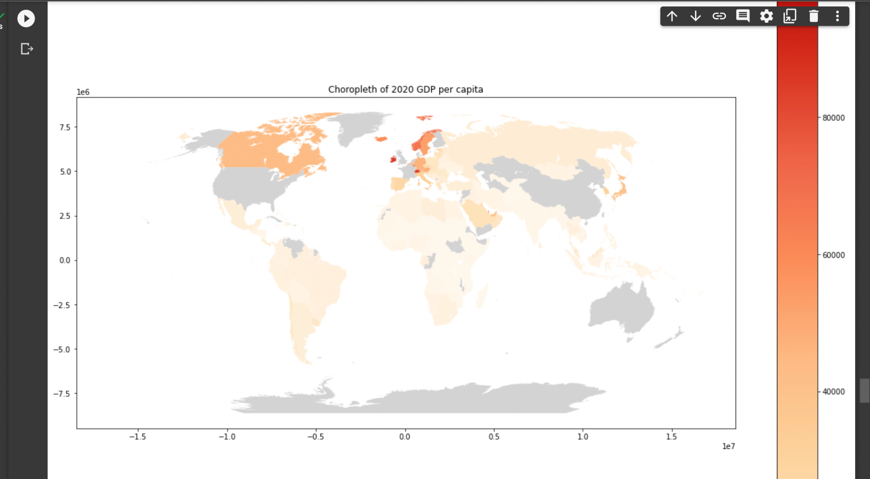
Exploration #4: Global Distribution of GDP Per Capita

Slide 24
Exploration #4: Global Distribution of GDP Per Capita
Takeaways:
-High concentration of high gdp/capita in European countries
-Lower gdp/capita in less developed countries
-where tf are the US and China and Australia

Slide 25
The Best Predictors of GDP
The Meat & Potatoes

Slide 26
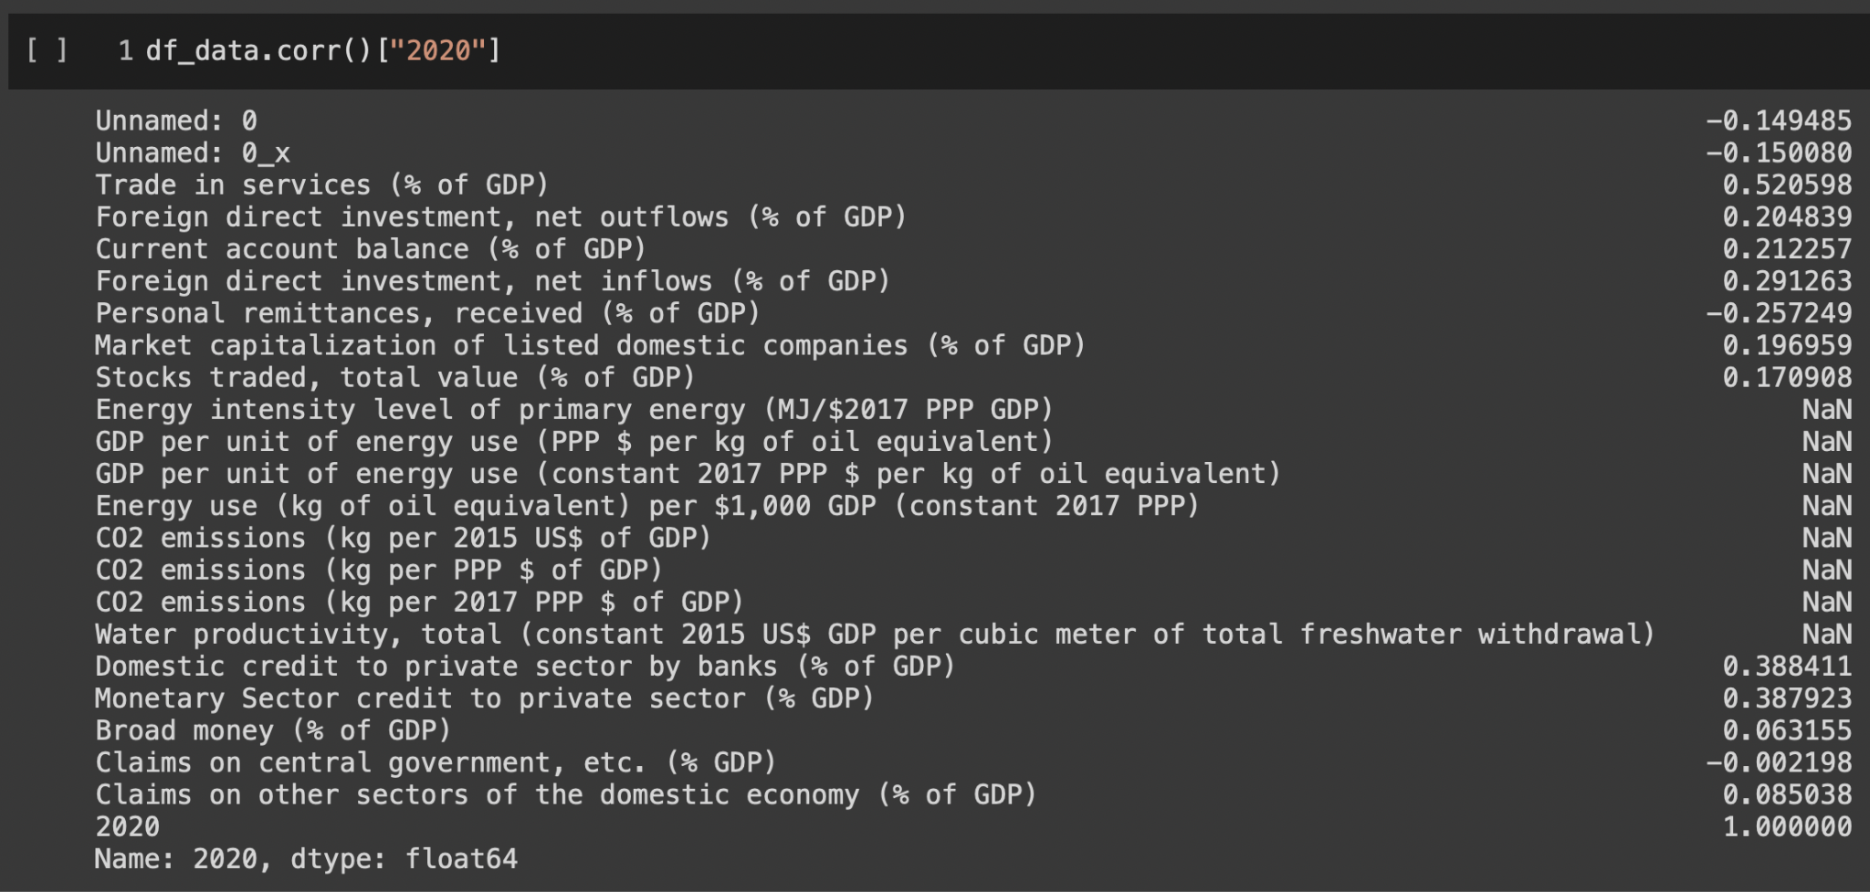
Picking the Variables

Slide 27
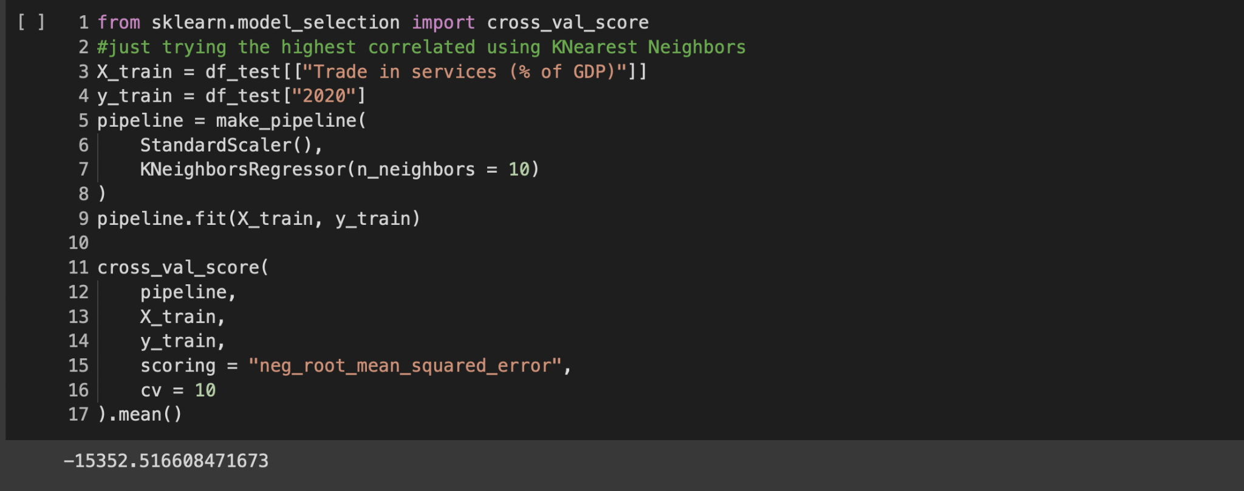
Trying the Highest-Correlated Variable Alone
Error is too high → let’s try all combinations of two variables out of our top 4

Slide 28
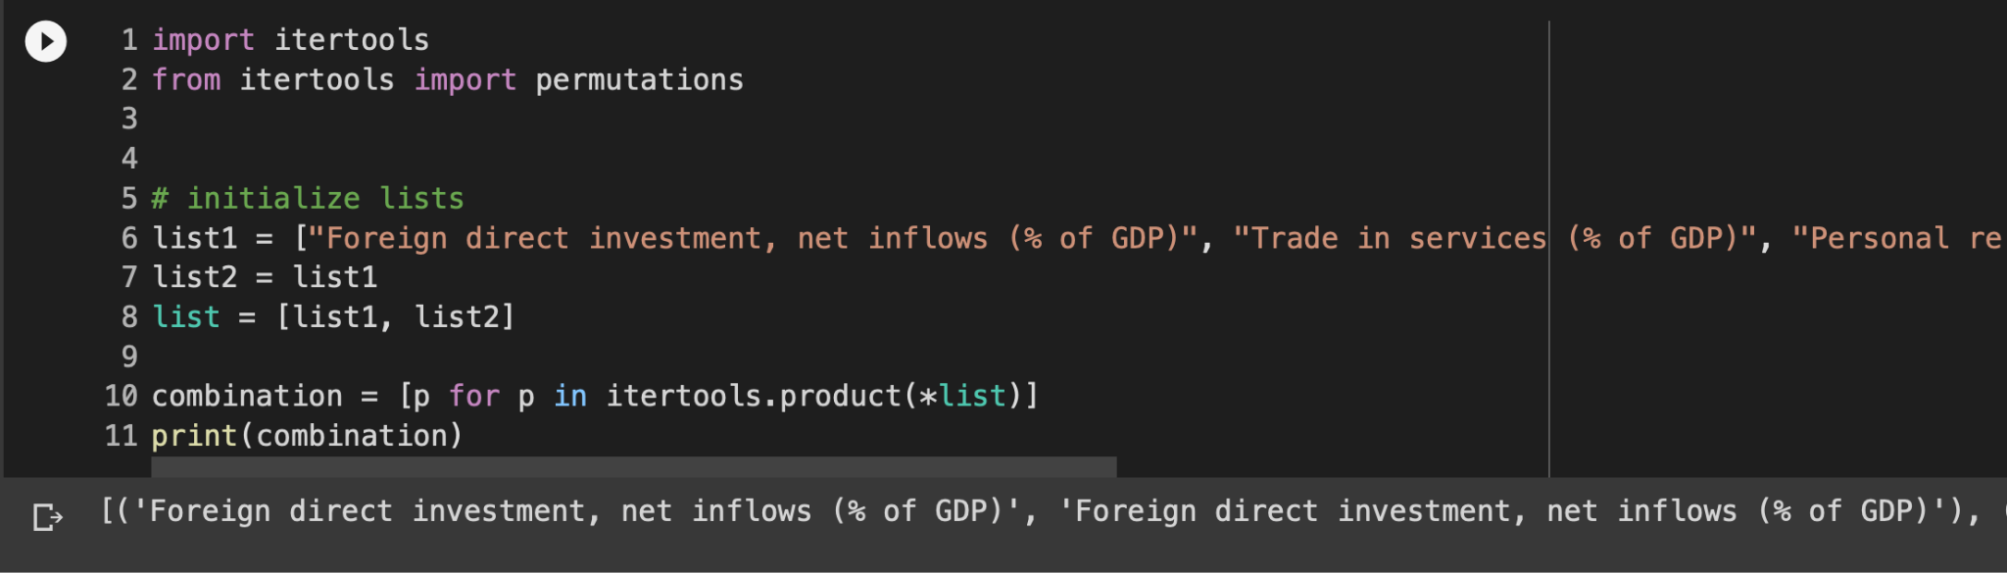
Getting all Combos of Two
Thank you Stack Overflow

Slide 29
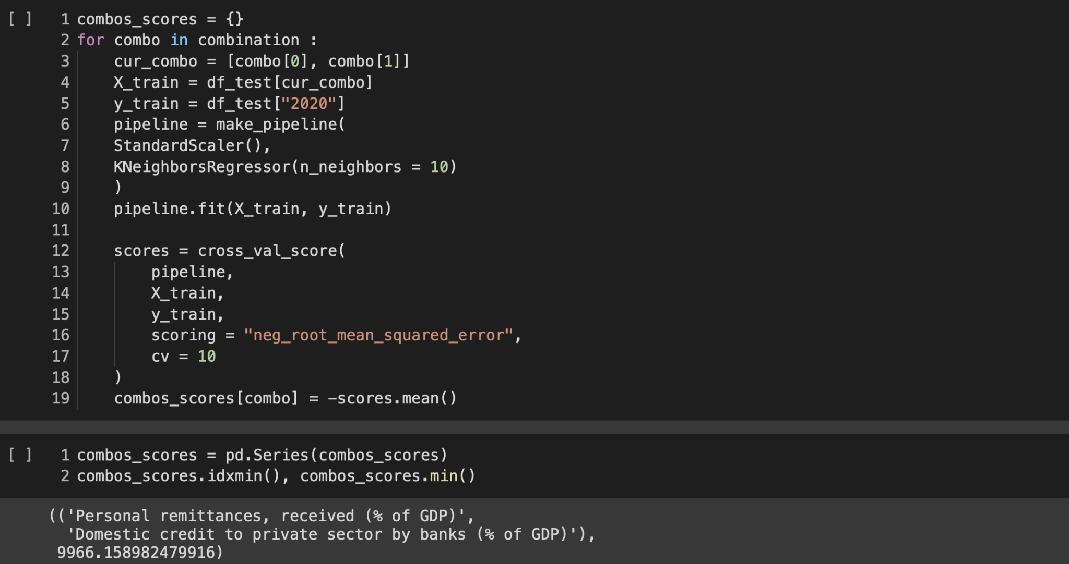
Using K-Nearest Neighbors to Find the Best Combo

Slide 30
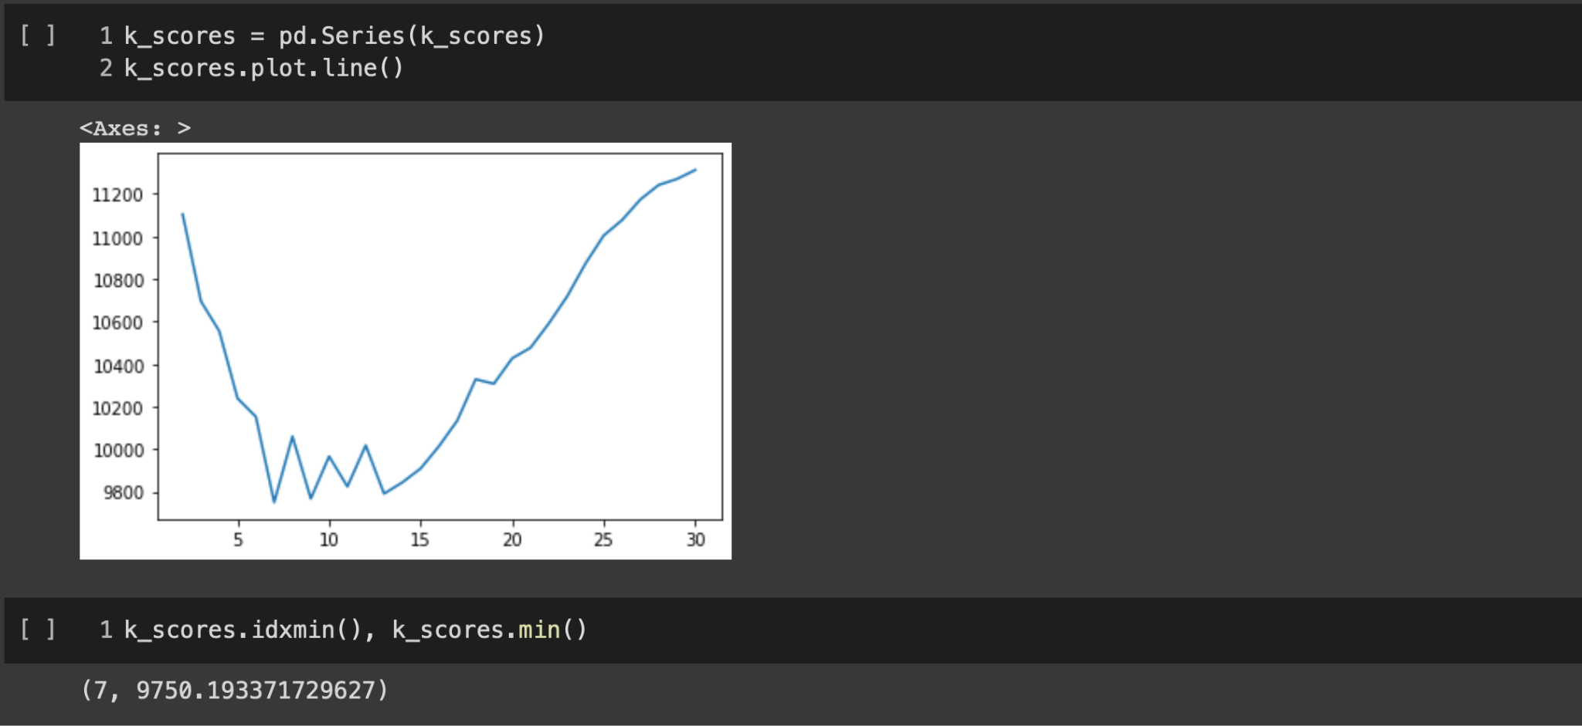
Finding the Best K-Value

Slide 31
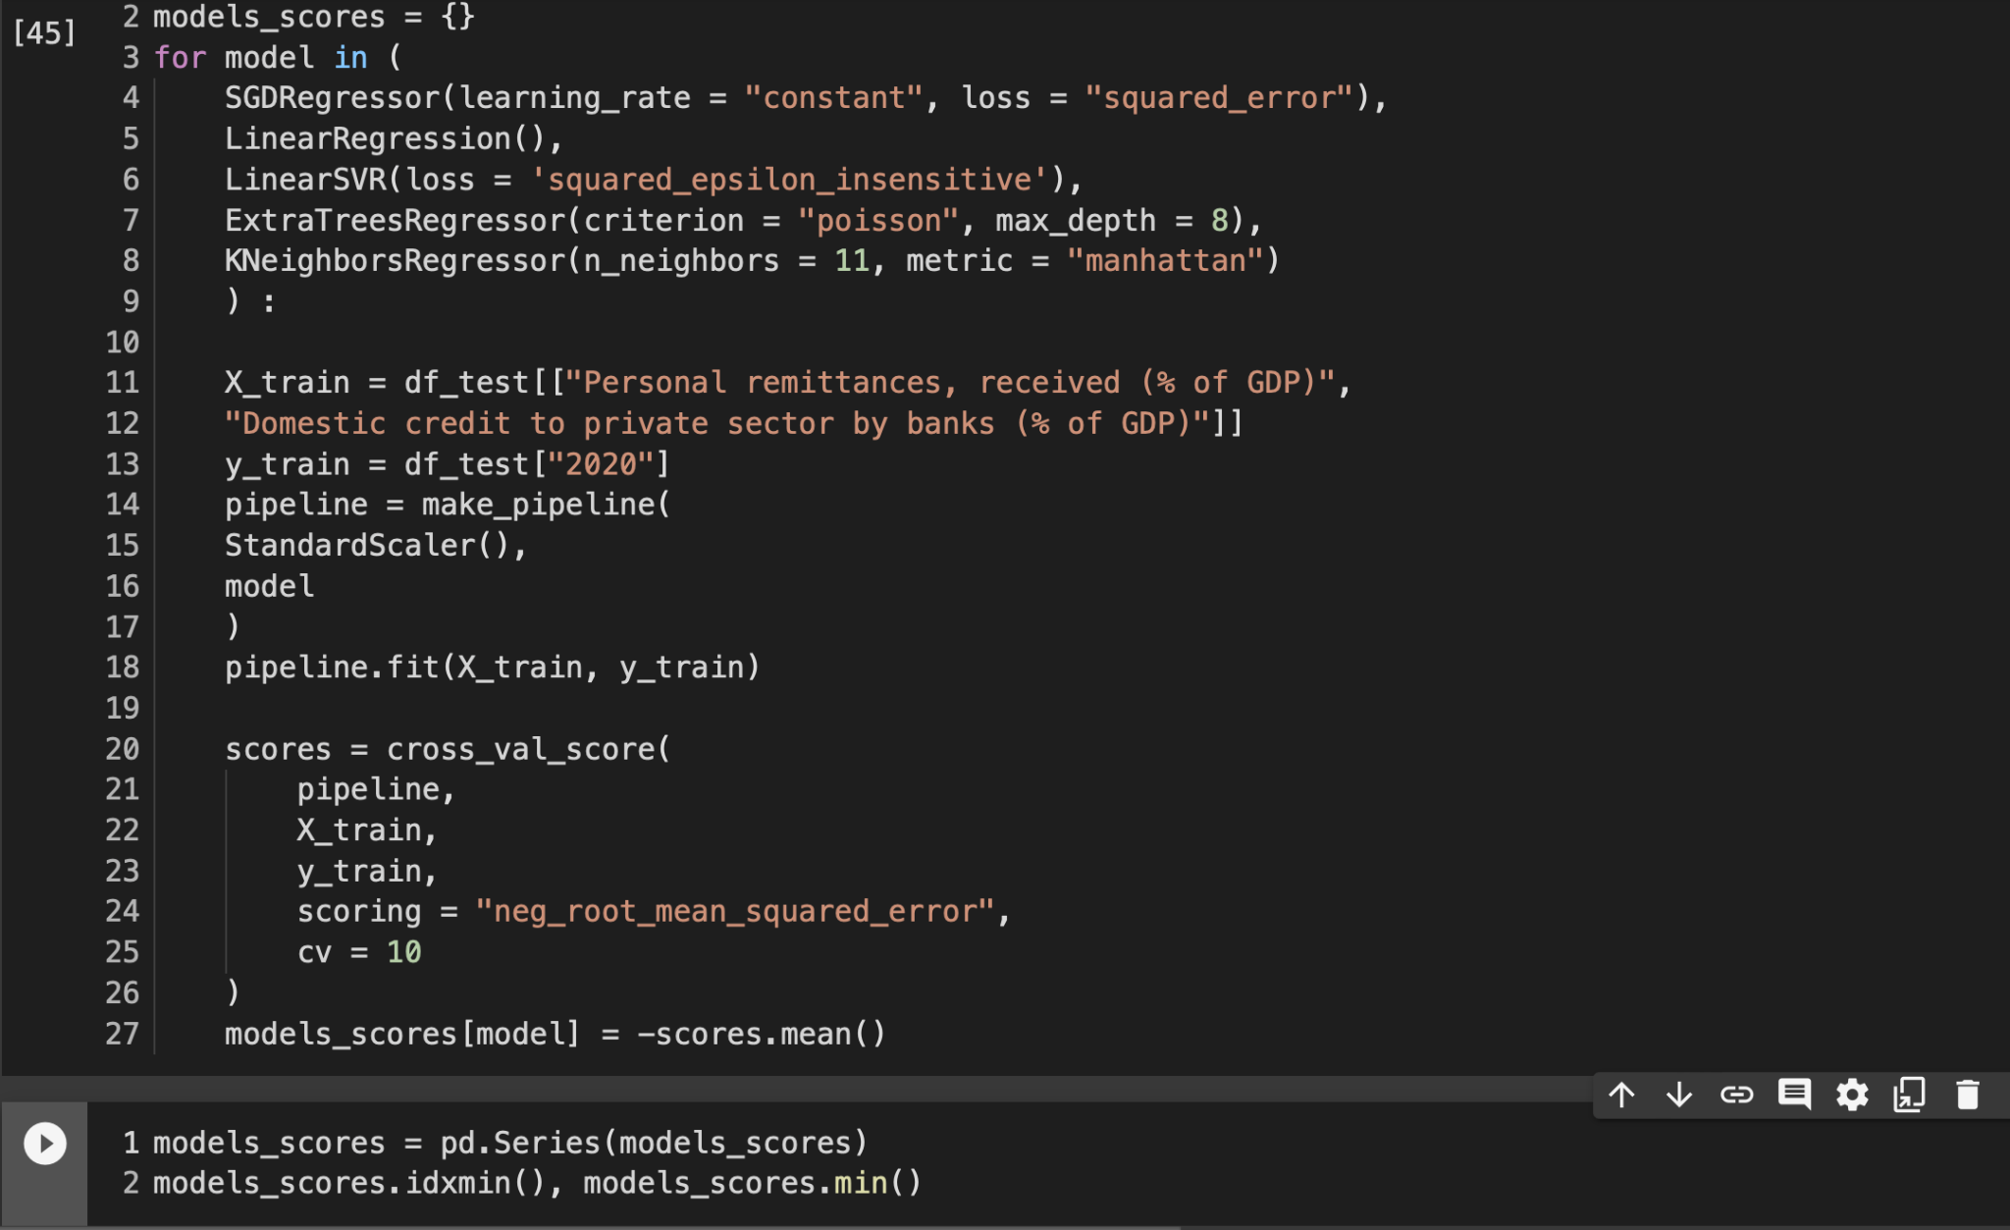

More Models
Hyperparameter tuned:
-SGDRegressor
-LinearRegression
-LinearSVR
-ExtraTreesRegressor
-KNeighborsRegressor

Slide 32
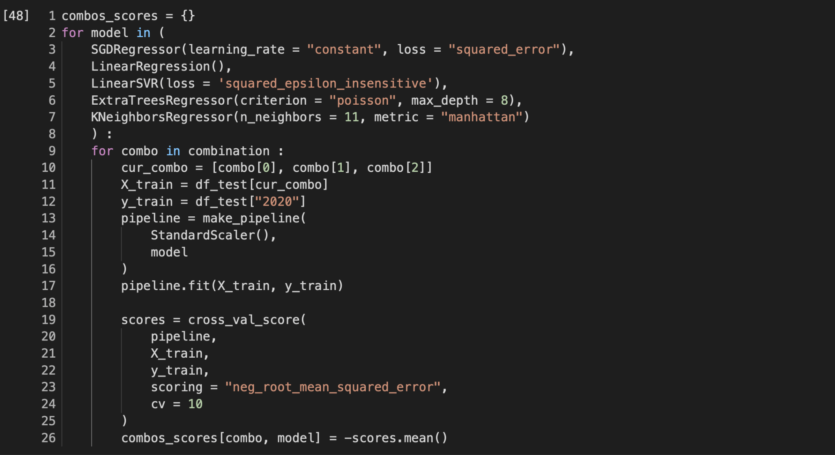
Finding the Best Model with Three Variables

Slide 33
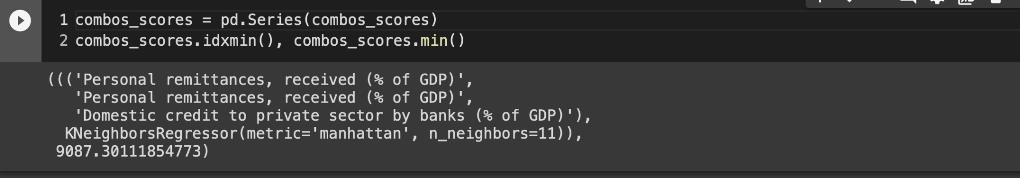
Finding the Best Model with Three Variables
What if we combined the top two models to get an even lower error?

Slide 34
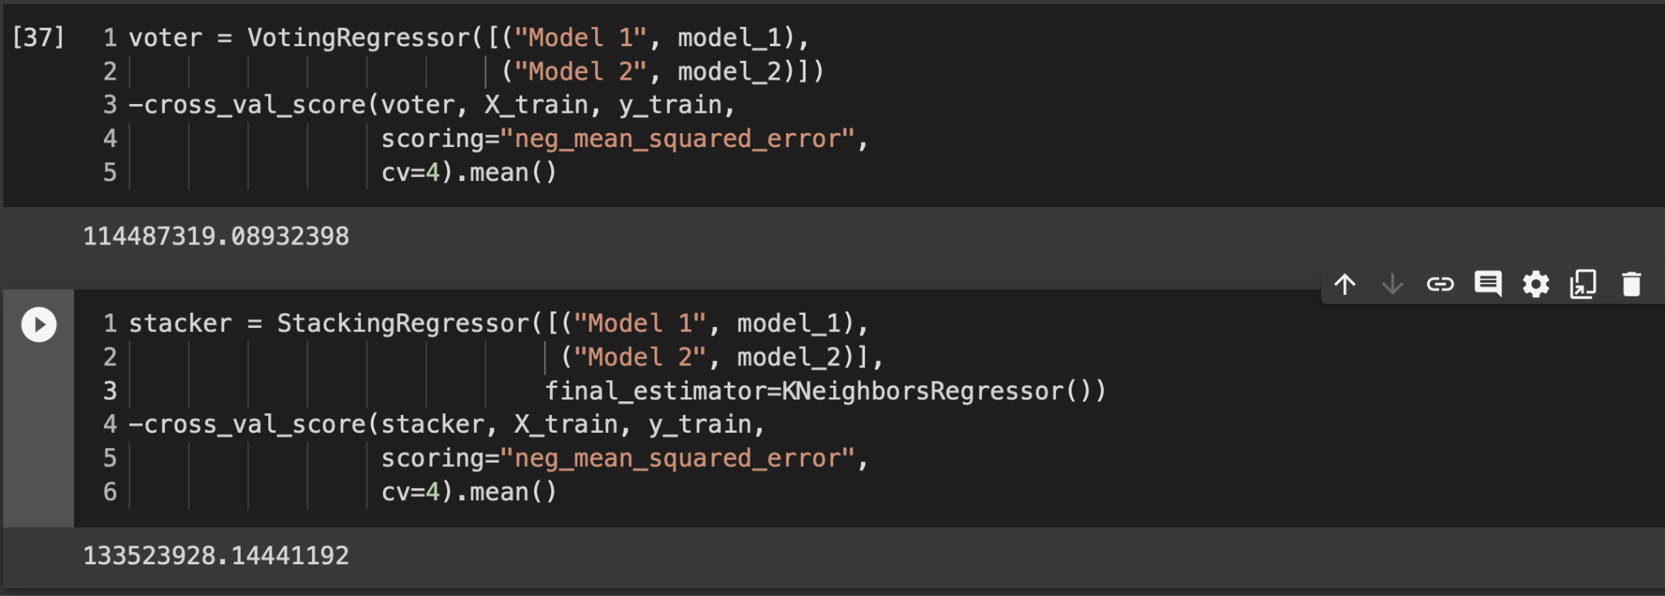
Ensembling to Further Reduce Error #backfired
Thanks Dennis’s slides

Slide 35
Economic Development = Bad Indicator of Production

Slide 36
Thank You/Questions

